Slide 1
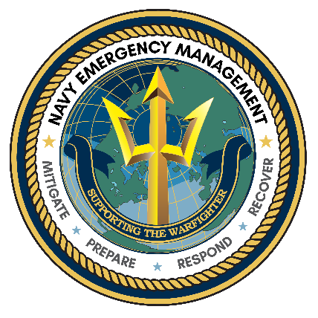


www.ready.navy.mil

Slide 2
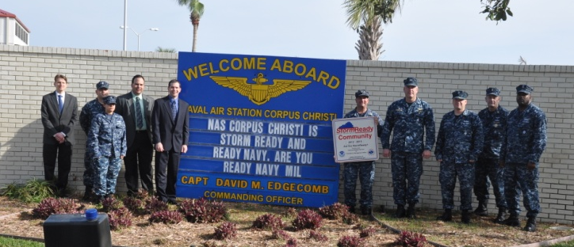
Ready Navy is…
…the proactive Navy-wide emergency preparedness, public awareness program, sponsored by CNIC. It is designed to increase the ability of every person and family on or near Navy installations to plan and prepare for all types of hazards.

Slide 3
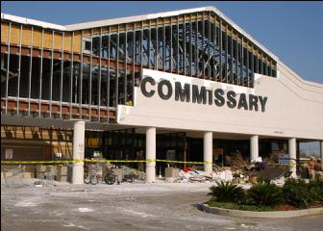
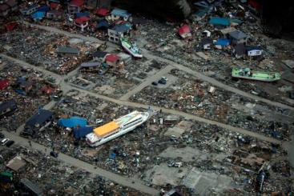
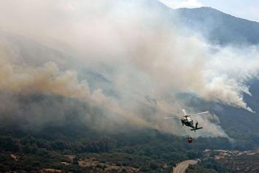
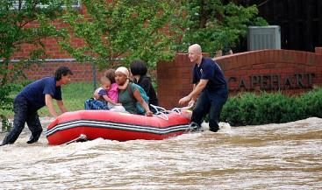
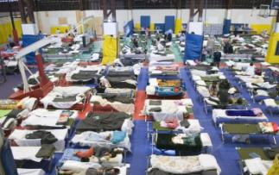
The Primary Goal
Create an active culture of emergency preparedness throughout the Navy enterprise for all types of hazards.

Slide 4
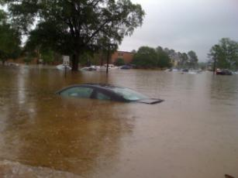
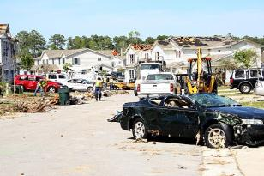
Be Ready Navy
Flood
Hurricane
Disease Outbreak
May have advance notice and time to prepare or evacuate
Tornado
Chemical Spill
Terrorist Strike
Could have little or no notice and little time to respond
Unless you are prepared for an emergency, your family could be without food, water, and even medicine, for several days.
Notes:
4

Slide 5
Stay Prepared
One major difference among the potential hazards, which will affect the decisions you make and the actions you take, is the amount of notice you may have.
In some emergencies—like a flood, hurricane, or disease outbreak—you may have advance notice and time to prepare or evacuate.
Other dangers—like a tornado, chemical spill, or terrorist strike—can come with little or no notice, leaving you little time to gather needed items.
Without prior preparation, your family could be without food, water, and even medicine, for several days. But while you may have little time to react, by thinking ahead you can have time to prepare for any emergency.
Be Ready Navy!

Slide 6
Potential Emergencies
Active Shooter / Work-Place Violence
Agricultural Incidents/Food Quarantine
Civil Disturbance (Riot, Strikes, Protests, or Mass Panic)
Drought
Earthquake
Environmental Pollution/Contamination
Explosion
Financial System Interruption or Collapse
Fire Hazards
Flood
Hazardous Materials Spill/Release
Hurricane/Typhoon
Infrastructure or Utility Loss or Interruption
Landslide/Mudslide
Oil Spill
Nuclear Reactor Accident/Incident
Nuclear Weapon Accident/Incident
Pandemic Influenza
Refugee and Migrant Operations
Severe Thunderstorms
Severe Winter Weather
Structural Failure/Collapse
Terrorism Incidents
Tornado
Transportation Accidents
Tsunami/Tidal Wave
Volcanic Eruption
Notes:
6

Slide 7
You Should Always
Be informed
Make a plan
Recognize your role
Understand the steps
Build a kit
Stay informed
The Ready program, empowers people as a preparedness partner before , during, and after an incident.
Notes:
7

Slide 8
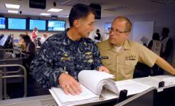
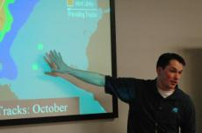
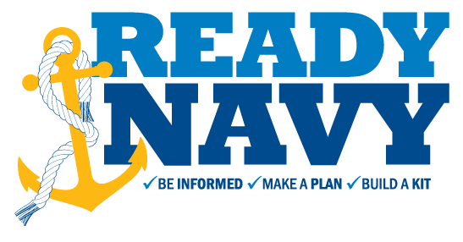
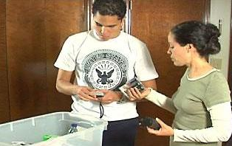
Steps to Prepare
Make a
PLAN
Be/Stay
INFORMED
Build a
KIT
Notes:
8

Slide 9
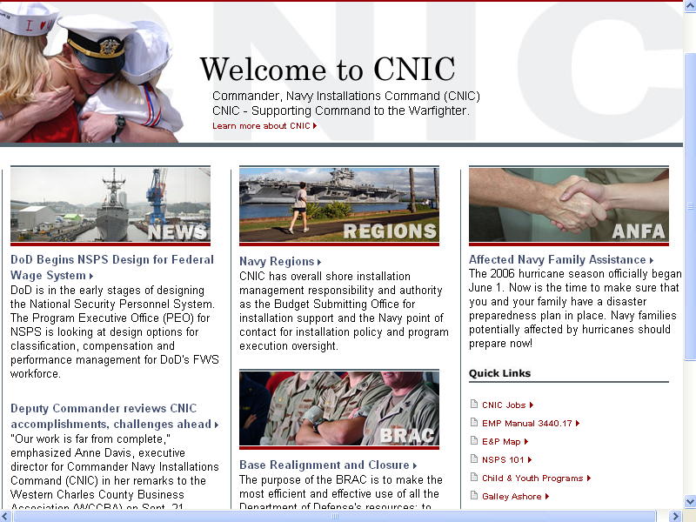
Be informed….
Resources are available
  - EM Office
  - Handouts
  - Web sites
Emergency Management website
www.ready.navy.mil or www.ready.gov

Slide 10
Mass Warning Notification System
In the event of an emergency, the Navy’s Mass Warning Notification System (MWNS) provides real-time alerts to the Navy community throughout the lifecycle of the incident/crisis or closure through:
              Navy Enterprise MWNS Components
              Giant Voice (GV): A voice announcing system using exterior speakers
              Interior Voice (IV): Interior speakers or sirens
              Computer Desktop Notification System (CDNS): An administrative broadcast across Navy computer networks that overrides current applications, thereby reaching all Navy users.
              Automated Telephone Notification System (ATNS): Notification system capable of providing voice and/or data messages to multiple receivers; telephones, cellular phones, email, SMS (Text), etc.
MWNS
ATNS
CDNS
GV
IV

Slide 11
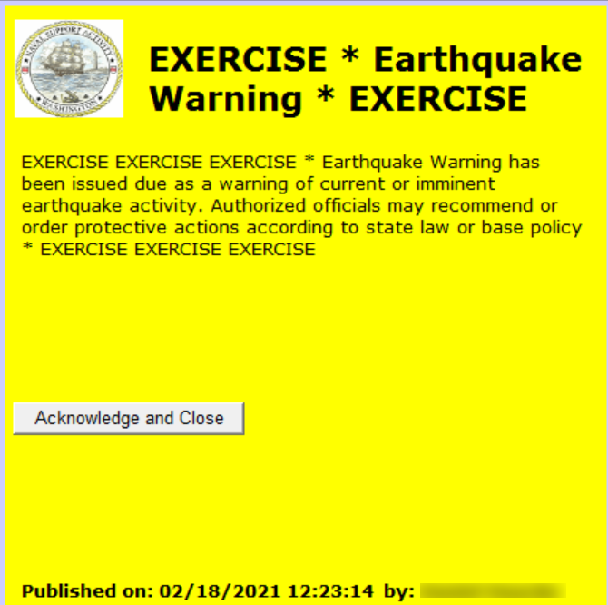
Mass Warning Notification System
Used by Emergency Management Personnel
Provides critical information during crisis events or other incidents to:
  First responders
  Mission critical personnel
  Base personnel
  Local agencies
Uses a layered approach
  Multiple Devices; Computer Workstations, Phone, Email, Text, etc…
  Selective Criteria: Base-wide, Key Personnel, Location, etc..
Computer Desktop Notification

Slide 12

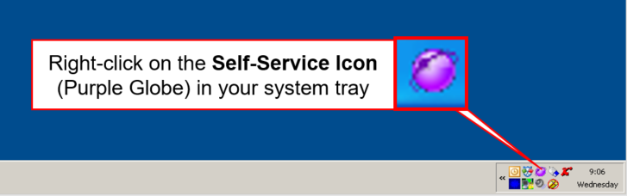

Computer Desktop Notification System
Self-Service Registration
Register your contact information to receive notifications during an emergency via Self-Service registration:
Select “Access Self-Service”

Slide 13
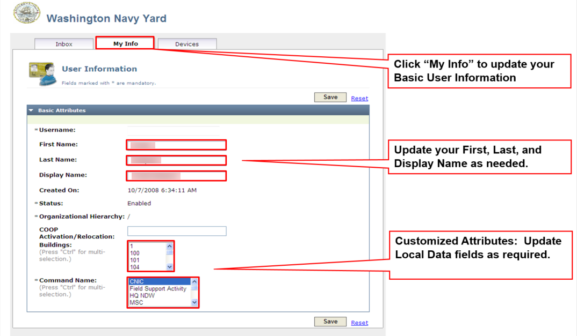
Computer Desktop Notification System
Self-Service Registration

Slide 14
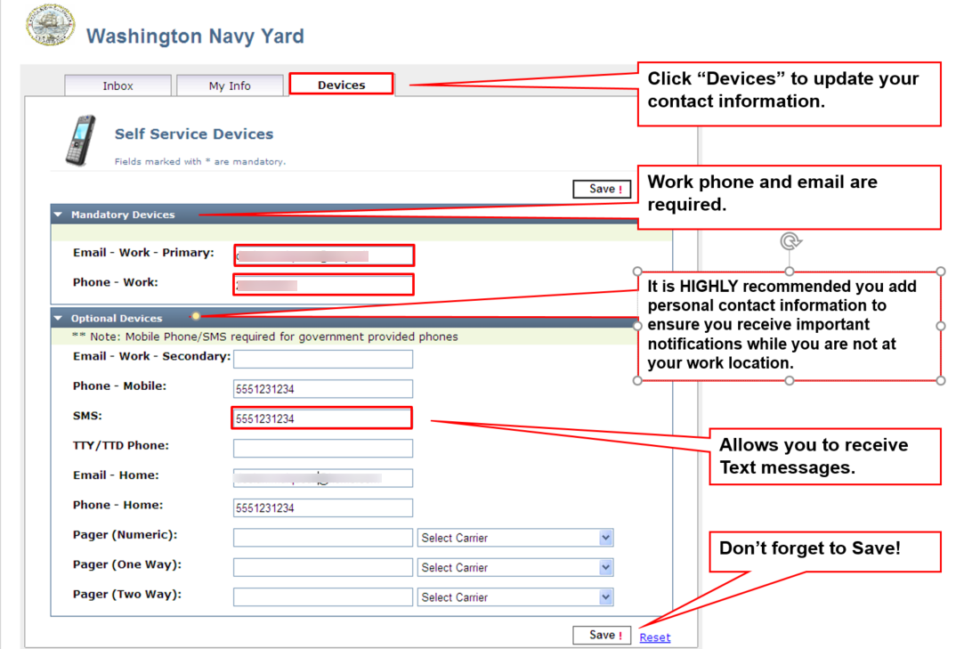
Computer Desktop Notification System
Self-Service Registration

Slide 15

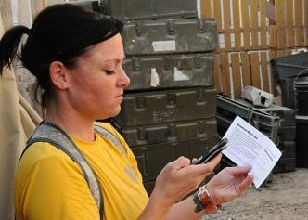
Step 2: Make a Plan
1. Written Emergency Plan
v
2. Communication
Plan
Notes:
15

Slide 16
Emergency Plans May Include:
Sheltering in Place
Sheltering in a Vehicle
Evacuation
Safe Havens or Shelters
Notes:
16

Slide 17
Lockdown VS Shelter-in-Place
LOCKDOWN
Lockdown is appropriate for threats posed from outside or inside the building. These threats could include a violent person attempting to enter your office, a perpetrator already inside, or nearby criminal or terrorist activity.
Lockdown Procedures:
Direct personnel to a position out of the line-of-sight of doors and windows.
Check outside of your office door (i.e., hallways) for nearby personnel, and move them into safe areas.
Close and lock all doors and windows.
Cover door window and close window blinds.
Turn off room/office lights and remain quiet.
Personnel outside of the affected building should move away from the building to the designated evacuation site or another appropriate, safe location.
Take attendance and report it to dispatch/designated personnel (include missing or additional personnel).
SHELTER-IN-PLACE
Shelter-in-place is appropriate for threats posed by atmospheric contamination. These threats could include accidents or attacks involving chemical, biological or radiological hazards.
Shelter-in-Place Procedures:
Close and lock all exterior windows and doors to prevent inadvertent opening.
Move all personnel to designated interior rooms for shelter-in-place.
Designated staff should bring updated attendance reports, grab-and-go bag, Automatic External Defibrillators (AEDs), and other equipment to the shelter-in-place locations.
Turn off all heating, ventilation, and air conditioning (HVAC) systems.
Take attendance and report it to dispatch/designated personnel.

Slide 18
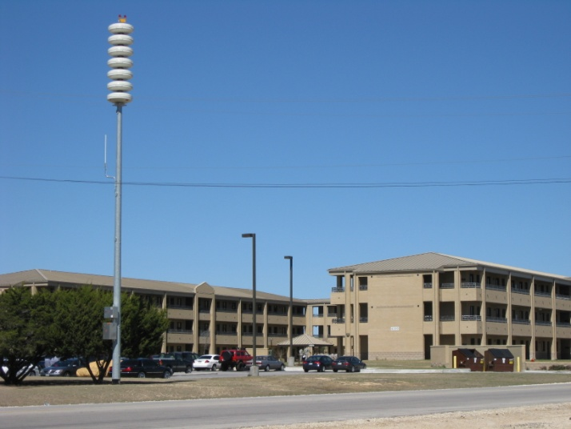
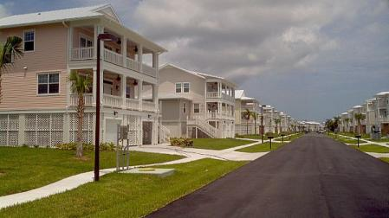
Plan for Sheltering in Place
Follow Giant Voice/Mass Notification instructions
Move inside
Have an emergency supply kit accessible
Secure exterior doors, windows, and entrances
Check for updates
Wait for the all-clear
Notes:
18

Slide 19

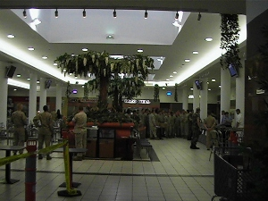
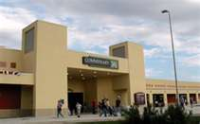
Area Shelters and Safe-Haven Locations
Shelters (Shelter-in-Place)
  - Home
  - Office
Local Safe-Haven
  - Red Cross Shelter, etc.

Slide 20

Plan for Sheltering in a Vehicle
Close windows, vents, and the AC
Drive away from visible gas clouds
Tune into the Emergency Alert
System or radio
Wait for the all-clear
Notes:
20

Slide 21
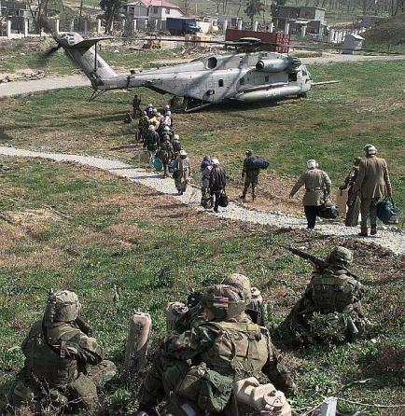
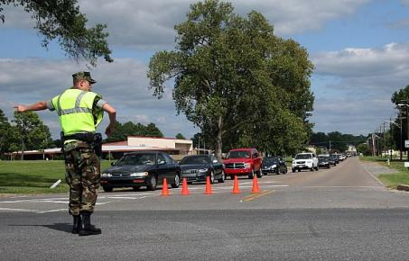
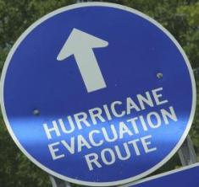

Plan for Evacuation
Notes:
21

Slide 22
Plan for Evacuation cont..
In the event of an emergency, installation and local Emergency Managers have plans and procedures to direct evacuation or movement of nonessential and nonemergency personnel and family members to safer locations. Essential and emergency personnel status will depend on the situation and your assignment to emergency or support teams. Additional procedures, using specified routes and transportation methods for personnel off base, are provided to installations overseas where the local government may not have the required capabilities.
Plan Ahead
Safe and effective evacuation requires planning ahead . Know ahead of time where you will go and how you will get there. There may be little advance warning. It is important to keep in mind that destructive weather, earthquakes, and other hazards may limit or eliminate some transportation methods. Be familiar with your installation’s plans and procedures. Review these periodically and whenever you change duty stations. Notify your Installation Emergency Manager or chain of command of any transportation needs you may have.
You should plan primary and alternative evacuation routes in advance, with appropriate maps in your emergency supply kit. Learn more about specific actions to take during an evacuation on the Ready Navy web portal or by contacting your local emergency manager.

Slide 23
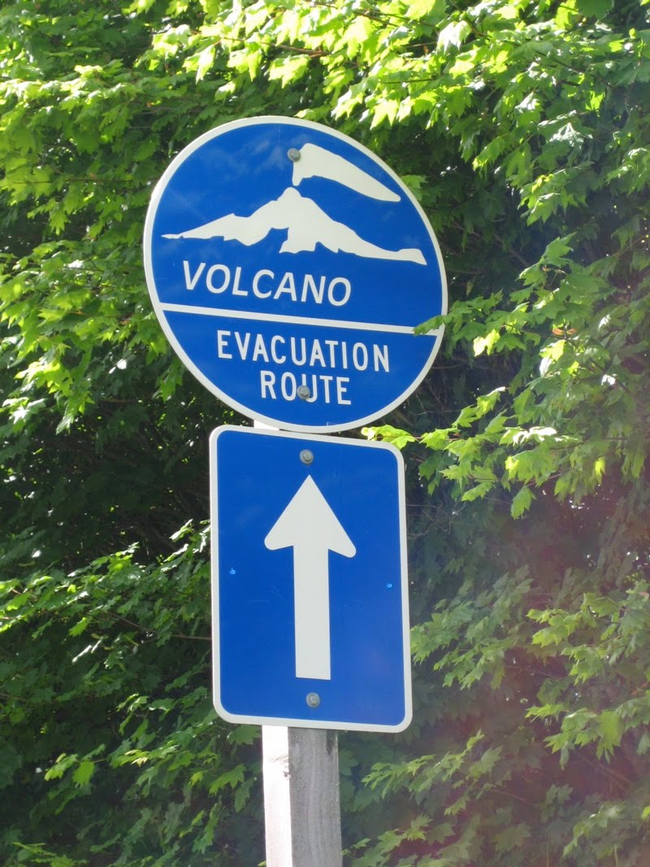
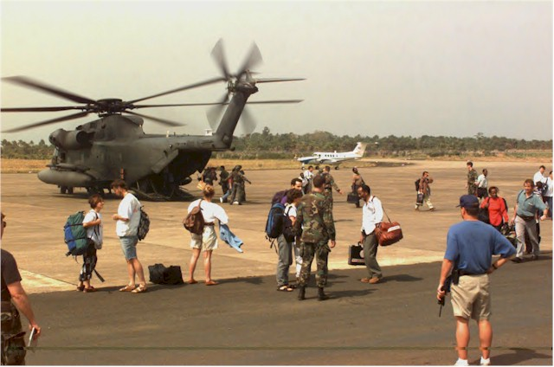
Evacuation Information
Non-essential personnel
  CAT 2 though 4 (non-mission essential;
  Including dependents)
Essential and First Responders
  CAT 1 & 5
Evacuation routes and procedures
  Provided via MWNS, Phone or AFN
  TV / Radio
  Follow directions of first responders
  Bring your evacuation kit with you
Notes:
- Overview of the CAT’s and notification nodes.

Slide 24
Personnel Categories OPNAVINST 3440.17
Category 1 - Emergency- Mission essential.
Category 2 - U.S. military family members, Non-essential U.S. military personnel, Navy civilian/Navy contractor to include their family.
Category 3 - Other personnel supporting U.S. operations, Non-U.S. citizens who are employees of the Navy, Navy contractor Foreign military personnel employed not considered mission essential.
Category 4 - Allied/Coalition Nation personnel, including host-nation personnel and third country nationals
Category 5 - First Responders

Slide 25
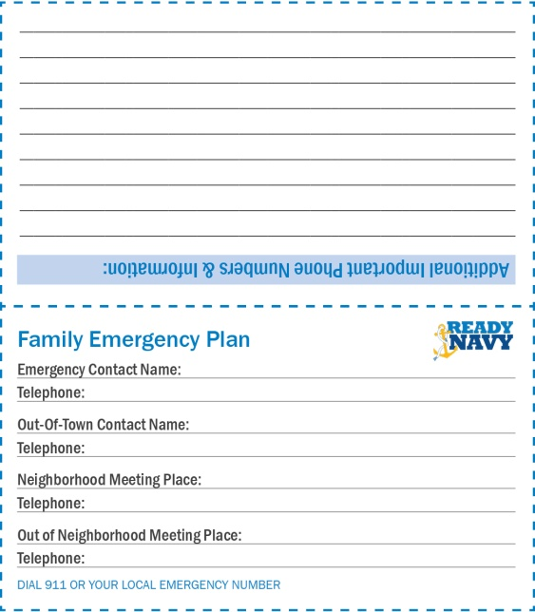
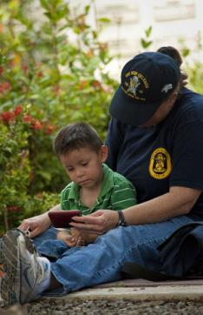


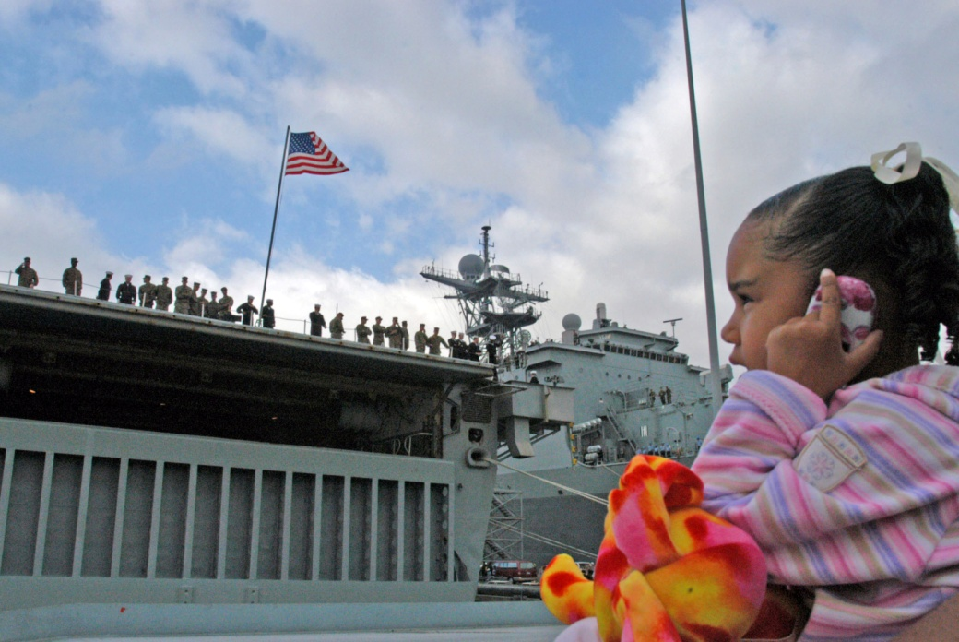

Make a Communication Plan
Make emergency contact cards
Designate an Out-of-Town Contact
Add text messaging
Practice your plan
File with Command
Notes:
25

Slide 26
Make a Communication Plan cont…
An effective communication plan is a written record, usually a sheet or a card, that instructs each member of the family on who to call and how to communicate critical information such as location and status with each other in the event of an emergency. Your family may not be together when a disaster strikes. Ensure that every individual in the family has a copy of the communication card to carry with them.
Designate an out-of-town , third-party contact to check in with if phone lines and cell phone towers are overloaded or out and you can’t reach each other.
Consider adding text messaging and social media sites like Facebook or Twitter to your communication plan if normal communication options are not available.
Practice your communication plan along with your evacuation plan to identify any problems or obstacles so that you may remedy them before a real emergency.

Slide 27

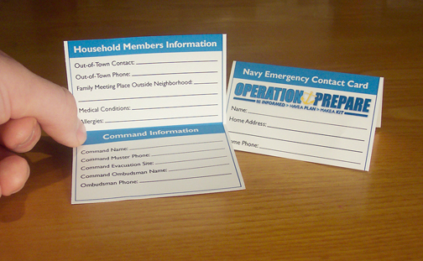
Keep in touch…
Know contact information
  - Chain of command, family, friends, etc.…
Make emergency contact cards (Ready.gov)
Conduct a dry run
Notes:
-

Slide 28
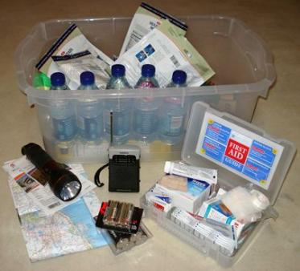
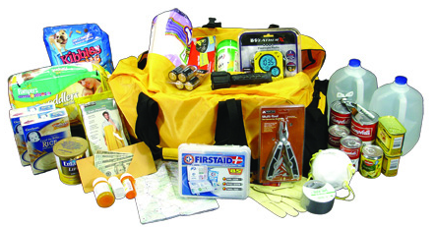
Step 3: Build a Kit
Build a basic home emergency kit
Make portable kits
    For vehicle
    For workplace
Update kits periodically
Notes:
28

Slide 29
Build a Kit cont..
Prepare yourself and your family for a disaster by building an emergency kit with enough supplies for each person in your household for at least three days. You could consider five days preparation in areas normally affected by earthquakes, typhoons, tsunamis, blizzards, and floods.
In addition to your basic home emergency supply kit, assemble a portable kit to take with you when you evacuate, as well as emergency kits for your vehicle and workplace. These kits should include a minimum of food, water, first aid supplies, and your family emergency plans.
After you have assembled your emergency kits, periodically evaluate their contents and their relevance to the threats in your area. Throw away and replace any expired or damaged medications, food, or water. Reassess and replace the contents, particularly after an emergency incident, so that you are ready for the next incident that may come your way.
These kits will enable you and your family to respond to an emergency more quickly. Your various emergency kits will be useful whether you have to shelter-in-place or evacuate.

Slide 30

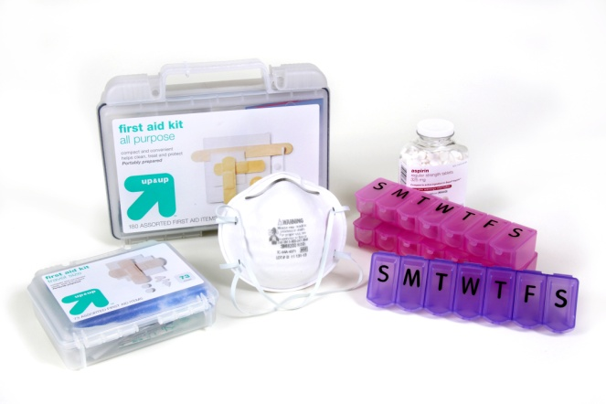
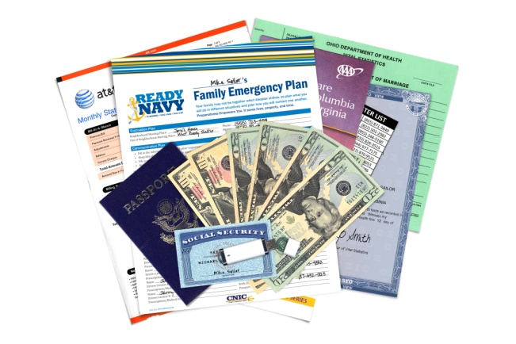
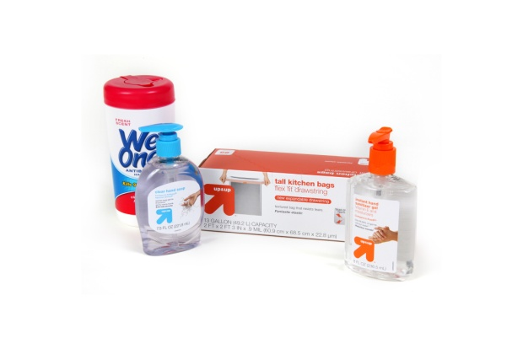


What to put in your emergency supply kit
Fill your kit with a 3-day supply of recommended items.
Visit www.ready.navy.mil for an emergency kit list.
Notes:
30

Slide 31
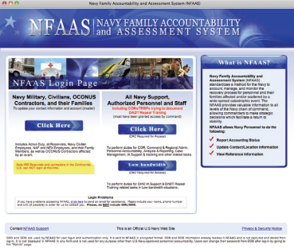
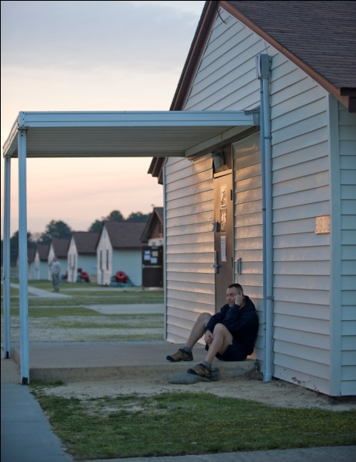
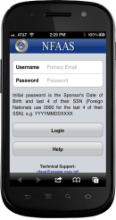
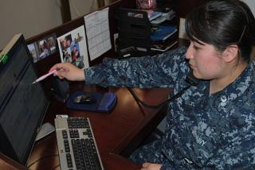
Plan to Muster:
Report your status and get help
REGISTER Your Information in NFAAS Before Disaster Strikes
REPORT Your Status (Muster) and Needs After a Declared Disaster
FIND REFERENCES for Planning and Recovery Anytime
https://navyfamily.navy.mil
Now NFAAS is easy to access during an emergency using your mobile device!
1-877-414-5358
Notes:
31

Slide 32
Plan to Muster cont…
Once you are in a safe place, muster with your command, your relatives, and your out of state contact, according to your plan. Navy personnel are required to report to their commands immediately upon reaching a shelter or safe haven no more than 48 hours after arrival.
Register your information before an emergency and report your status and needs after a declared disaster in the Navy Family Accountability and Assessment System or NFAAS. NFAAS registration is a command requirement. Find references for planning and recovery, with easy access by website at https://navyfamily.navy.mil, or by phone at 1-877-414-5358 or My Navy Career Center at 1-833-330-6622.

Slide 33
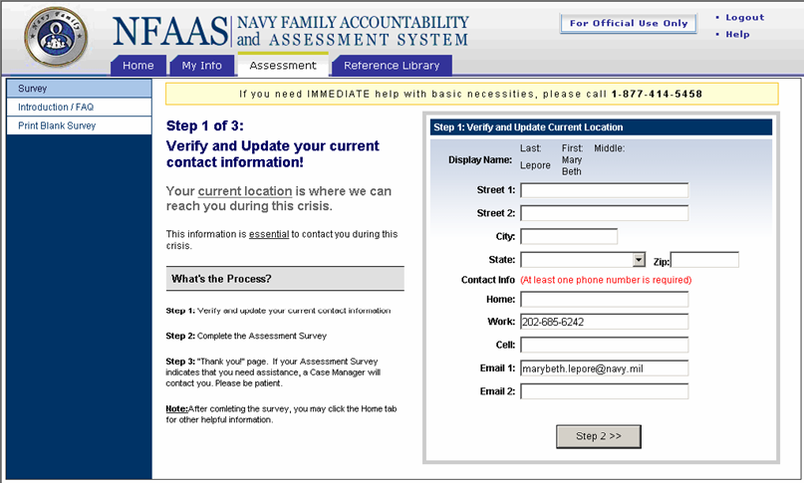
Update your NFAAS
If you or your family has been affected by a declared emergency, you can report your needs
  - Phone: 877-414-5358
  - TDD: 866-297-1971
  Navy Family Accountability and Assessment System
NOTE: Service members not in the Navy, contact your Chain of Command
Notes:
-

Slide 34
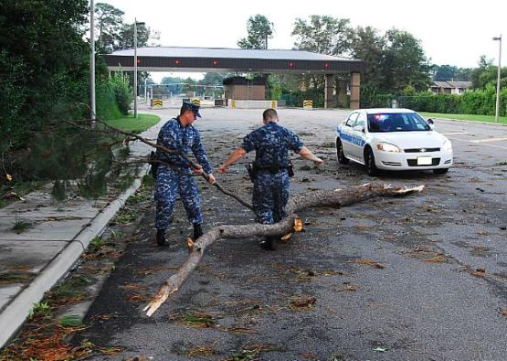
Stay Informed through
Ready Navy
www.ready.navy.mil
Notes:
34

Slide 35

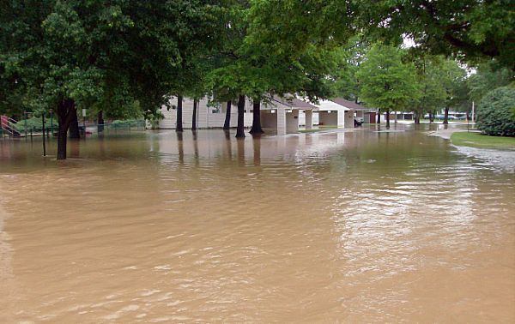


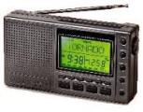



Stay Informed through
General Resources
Television, radio, internet, social media
Notes:
35

Slide 36
Stay Informed cont..
Tune into general resources such as television, radio, and the Internet for media alerts and updated information throughout an emergency.
Through the Emergency Alert System, or EAS, a national public warning system, the President can address the American public during a national emergency. State and local authorities also use EAS to deliver important emergency information, such as AMBER alerts and weather information about imminent dangerous weather conditions targeted to specific areas.
Be sure to also link to your installation’s Facebook page, Twitter feed, and other social media for another avenue to get the critical information you need to stay informed during an emergency.

Slide 37
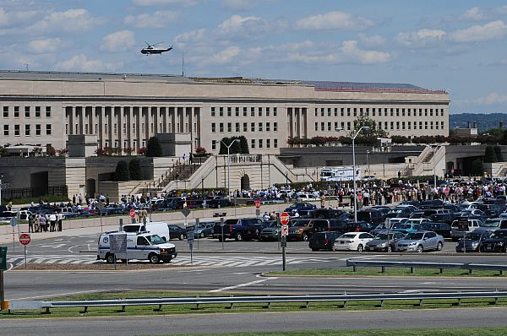



Stay Informed through
Government Websites and Mobile Apps
Government Websites (Ready.gov, FEMA.gov, CDC.gov)
Notes:
37

Slide 38

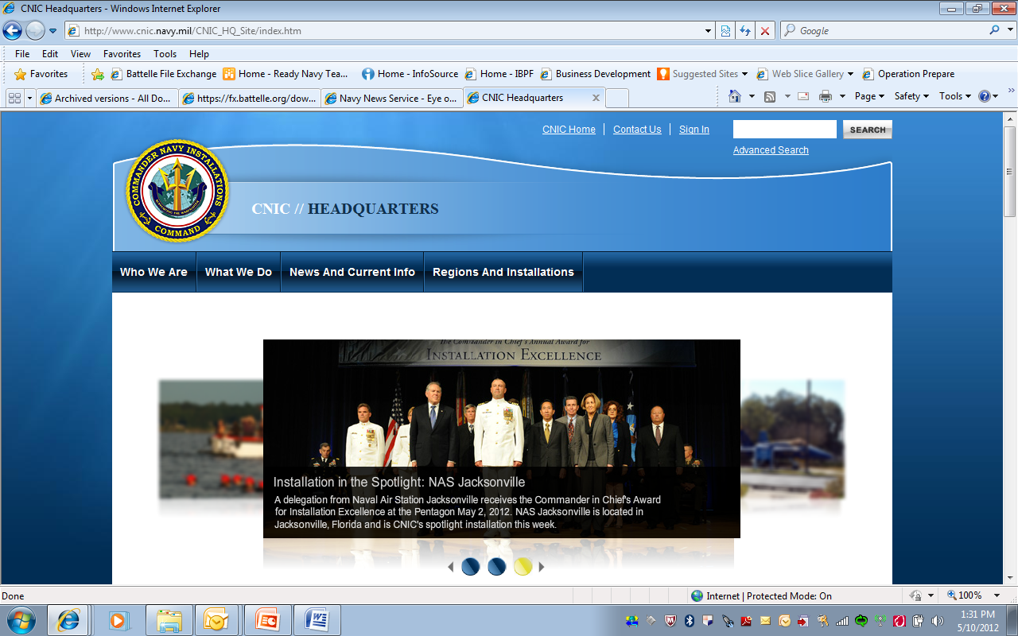
Stay Informed through
CNIC
Commander, Navy Installations Command www.cnic.navy.mil
Notes:
38

Slide 39
Stay Safe and Be Prepared!
Congratulations, you have completed this course.

